Slide 1
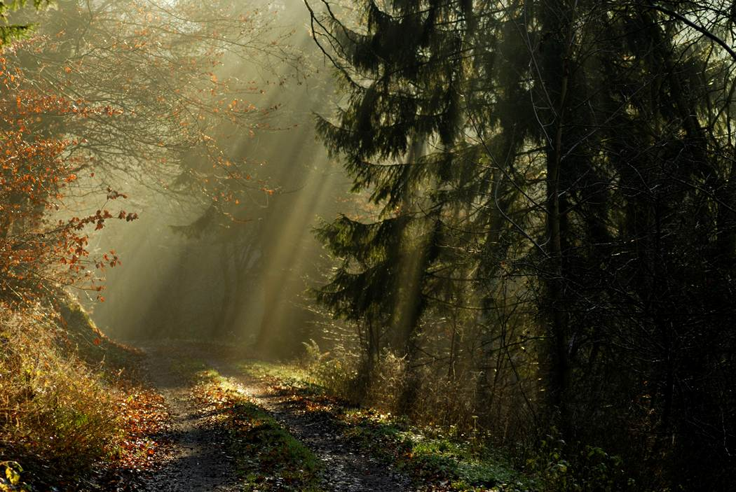
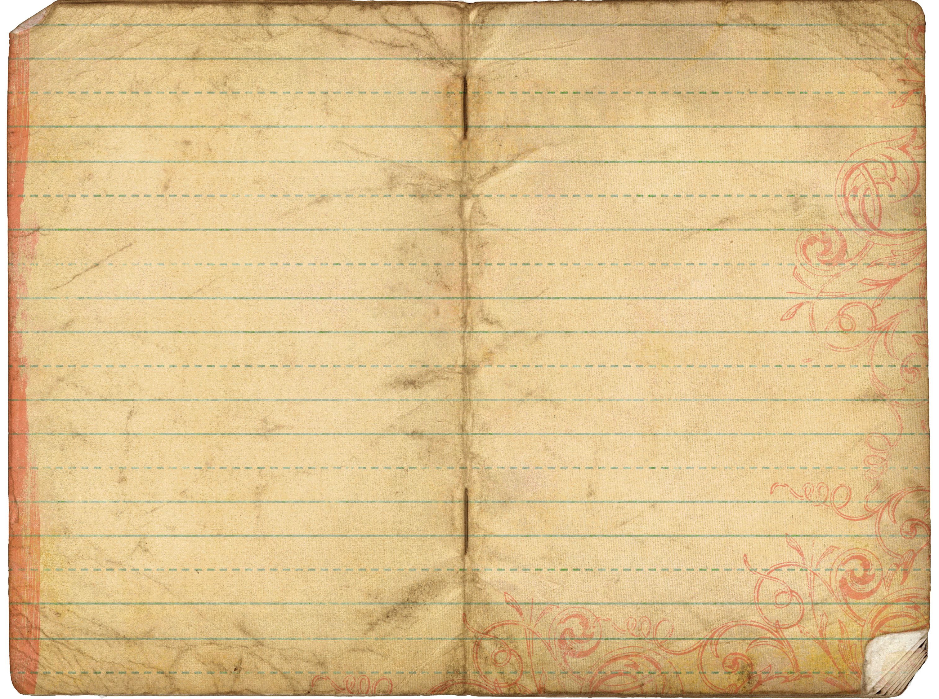
Contact Us
The Trek and its creators can be reached:
By Email: info@thetrek.org
By Mail: 2750 Bible Camp Road Suite 3
Rhinelander, WI 54501
By Phone: (715) 203 - 0504
Blog: http://infothetrek.wordpress.com
Facebook: Click here to view our Facebook Page
Twitter: http://twitter.com/infothetrek
Forum: http://thetrek.forumotion.com
Our main office is located on the grounds of Crescent Lake Bible Camp in Rhinelander, Wisconsin. We would like to thank them for providing the meeting space and equipment necessary to allow us to start our outreach.
All information in The Trek is intended for educational purposes. If you find yourself struggling with severe depression, suicidal thoughts or the desire to hurt yourself or others, please seek professional help immediately.
The Trek
What Is The Trek?
Home
Programs
History
Get Started…
Contact Us

